Slide 1
Efficient Use of Battery Arrays
Building Knowledge on Battery Technologies in Research Infrastructures (RIs)
Václav Bernášek - ELI ERIC

Slide 2
Objective of the Training
Discover the potential of battery storage - why it matters, how it works, and where the market is heading.

Slide 3
What Are the Key Challenges for Research Infrastructures?
Insights from the FlexRICAN Energy Questionnaire
Power quality issues
Stability and consistency of electricity supply
Grid reliability concerns
Risks of interruptions and fluctuations
Power consumption limits
Constraints on maximum energy demand
These challenges highlight the need for efficient energy management and advanced storage solutions to ensure stable and reliable operations.

Slide 4
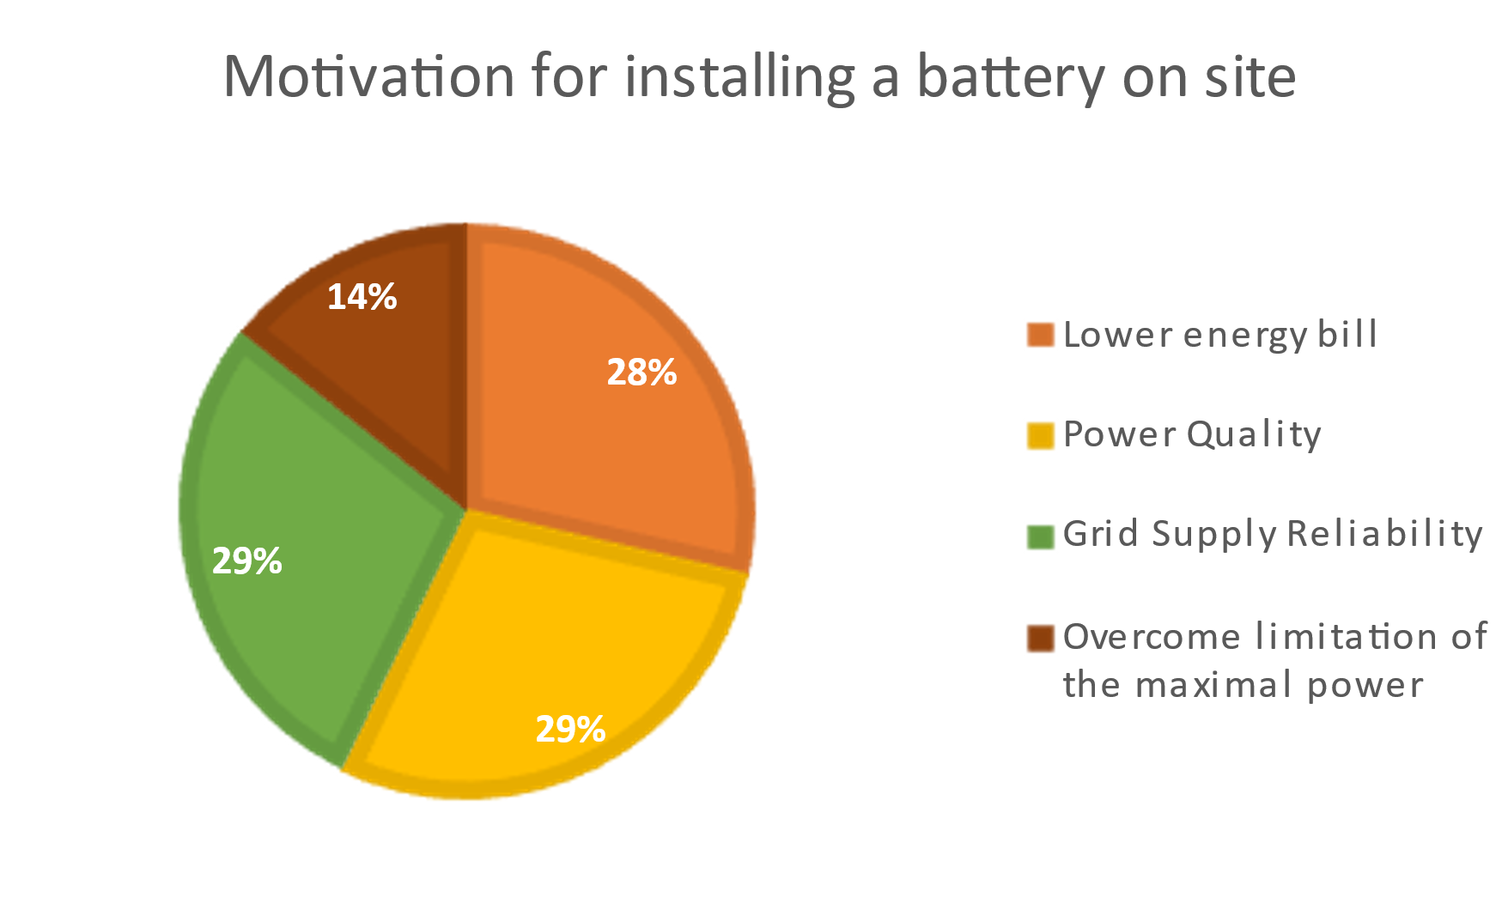
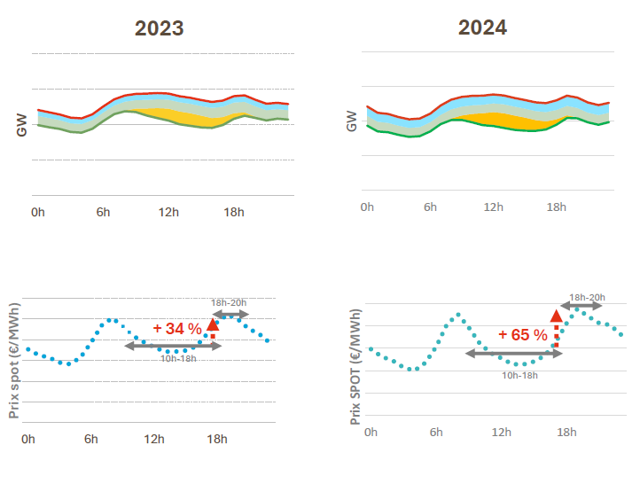
Selected benefits of battery storage for RIs
Electrical power quality defects mitigation:
Brownouts
Blackouts
Frequency deviation
Current-voltage phase shift
Harmonics
Protection of sensitive equipment
Electricity cost reduction
Depends on the style of electricity ordering
EU subsidies
Sustainability
Source: Ecole des Mines de Paris

Slide 5
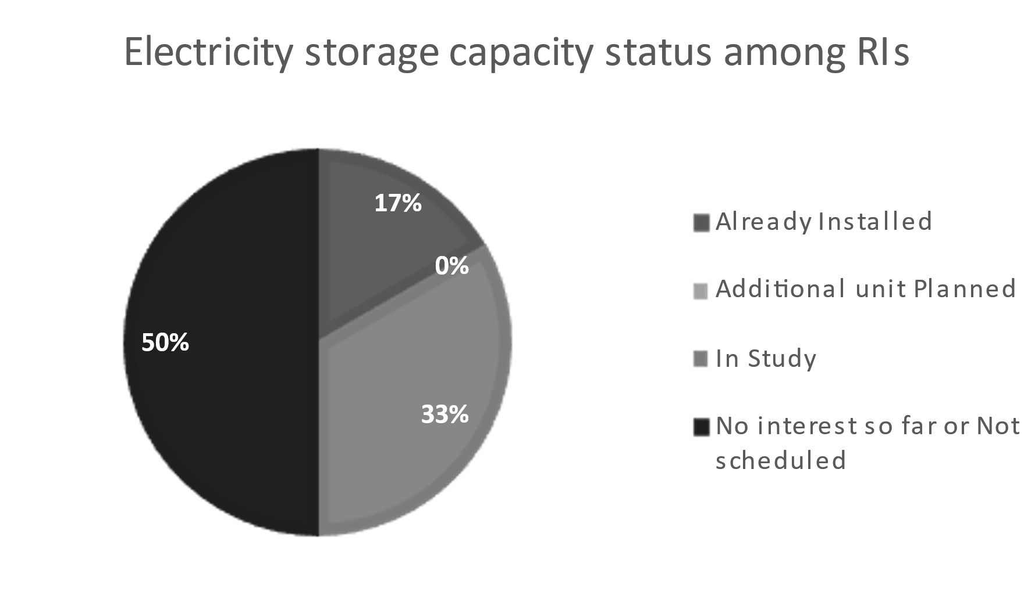
Motivation for the Training
42% of Research Infrastructures cite lack of information, complexity, or prioritization as key reasons for not implementing battery storage.
(FlexRICAN Energy Questionnaire)

Slide 6
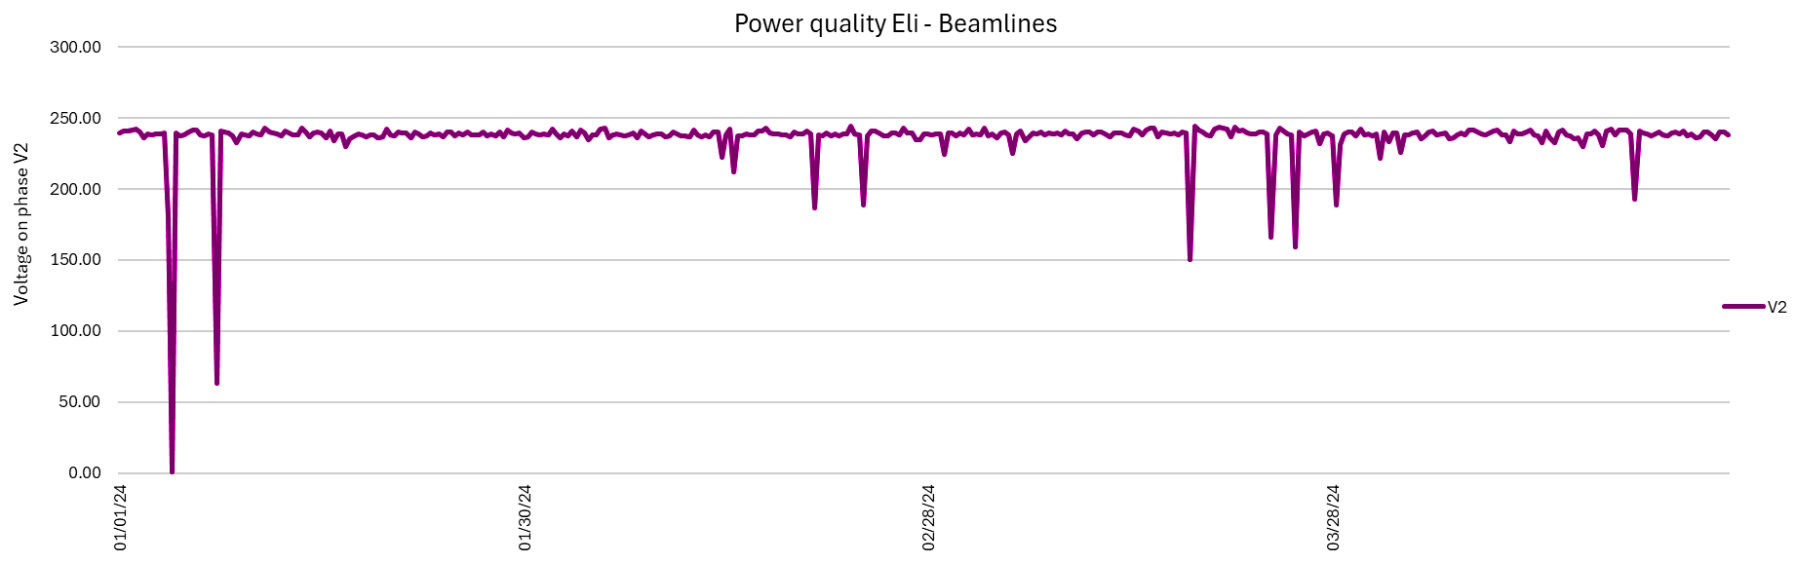
FlexRICAN WP4.1
Maximizing the efficiency of integrating battery arrays into the energy ecosystem
D7
A streamlined energy chain
2.2027
This work package examines the impact of external power supply on the internal electrical network and explores strategies to adapt to power quality issues from the supplier.
Exploitable results:
Tool: Presents a schematic for connecting devices in a sequence designed to mitigate power quality issues while simultaneously reducing costs and emissions based on user inputs.
Webpage: This webpage offers insights from research and questionnaires, practical examples, and a guide to using the tool.
M3
Functional prototype of technology chain (UPS, UPQ, DA, PVP)
3.2026

Slide 7
FlexRICAN WP4.2
Electrical storage for power modulation
D8
Cost models for participation to fast demand-response service systems
2.2027
This work package studies the impact of internal electrical power storage on the external electrical network by joining the primary and secondary reserve mechanisms.
Revenues through ancillary services
Minimizing the costs
Power output reserves
(% of peak output of
primary reserves)
M4
Procedure and Cost models for large capacity batteries or participation to service systems at one of the participant RI’s
9.2026
Power output reserves
(% of peak output of
primary reserves)

Slide 8
What is energy storage
Energy storage is the capture of energy produced at one time for use at a later time.
A device that stores energy is called an accumulator or battery.
Consumer electronics
Embedded Vehicle
Stationary

Slide 9
Services that can be adressed by energy storage
Stationary grid storage
Source: EASE

Slide 10
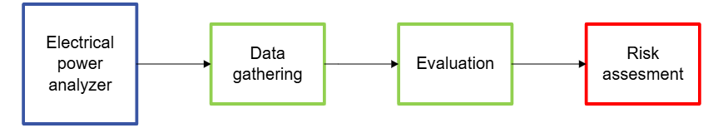
How to define electrical power quality problems
Power output reserves
(% of peak output of
primary reserves)
Recommendations:
Electrical power analyzer downstream of the supplier's power supply
Portable electrical power analyzer

Slide 11
Available technology for power failure mitigation

Slide 12
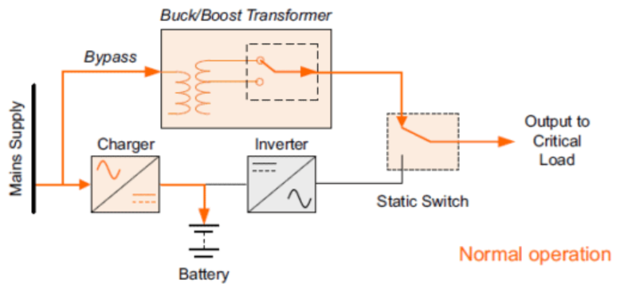
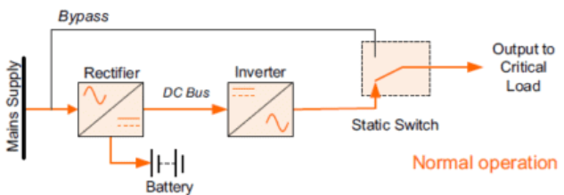
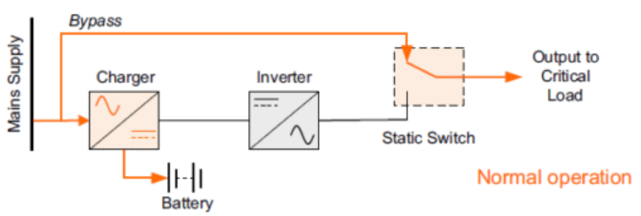
Connection types for battery storage
Online UPS
Line-interactive UPS
Offline UPS
Source: https://www.kohler-ups.co.uk/

Slide 13
Battery storage - available technology

Slide 14
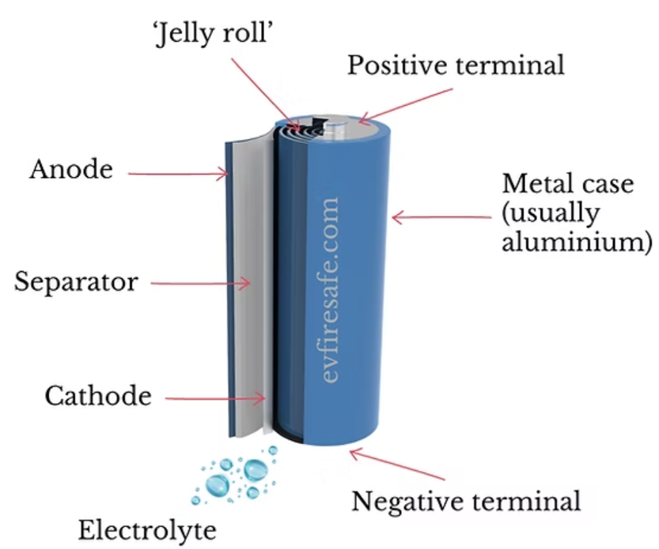
Li-ion batteries
Benefits:
Fulfilling widest requirements
Longest life
Cost efficient
High energy density
Fast charging
Most popular – rapid development, economy of scale
Drawbacks:
Safety concerns
Environmental impact
Temperature sensitivity
Source: evfiresafe.com

Slide 15
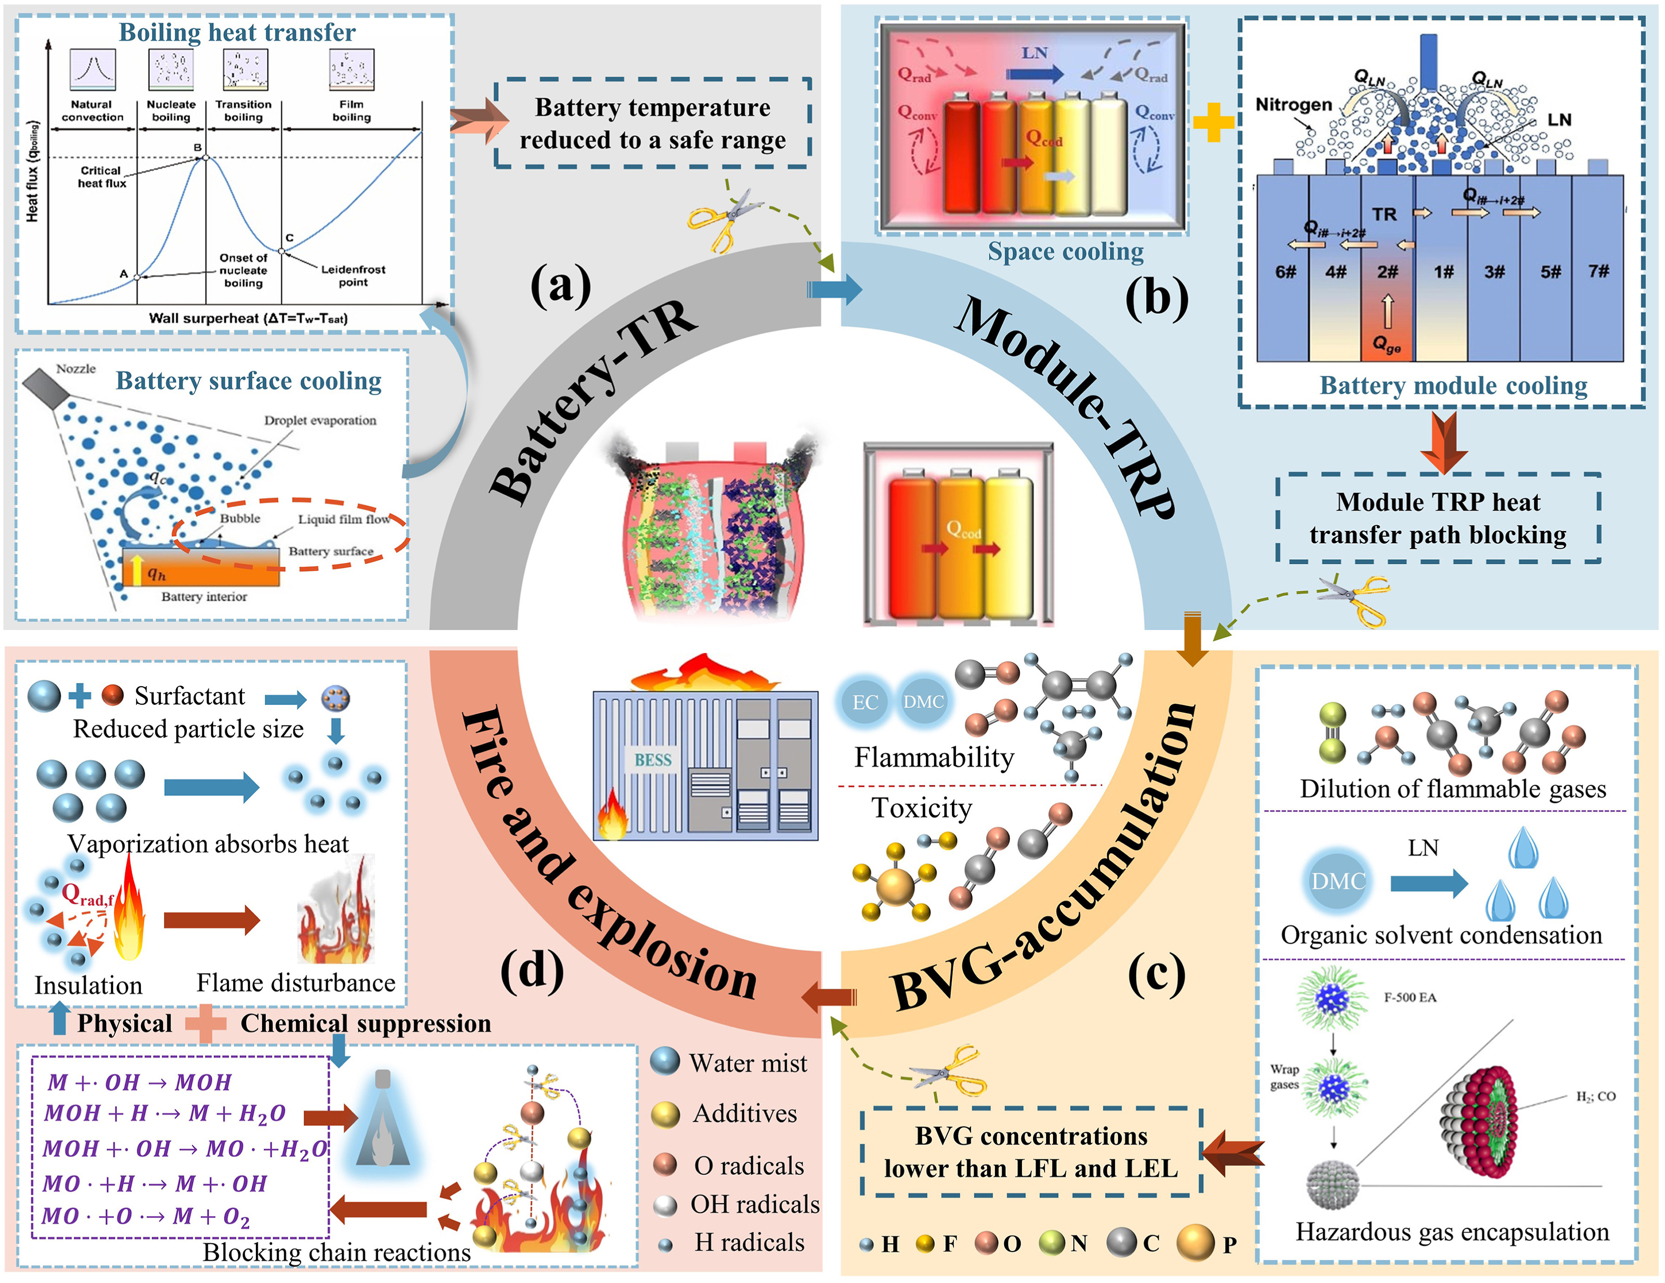
Li-ion Safety
Overcharge protection additives
Include thermal management systems, battery management systems (BMS), venting devices, and fire-retardant materials
Include additional protection in the high-voltage system
Redundant in safety systems
Enhanced manufacturing quality and certification processes for overall safety and reliability.
Source: https://ars.els-cdn.com/

Slide 16
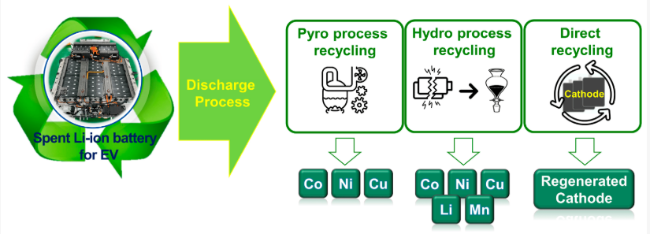
Li-ion recycling
Currently 70% of battery weight is recycled (EU requirement 50%)
Few High value-added materials can be recovered
Current cost of the recycling process: around €1 to €3/kg
Source: Optimization of the Electrochemical Discharge of Spent Li-Ion Batteries from Electric Vehicles for Direct Recycling by Hyunseok Lee, Yu-Tack Kim and Seung-Woo Lee, 2023

Slide 17
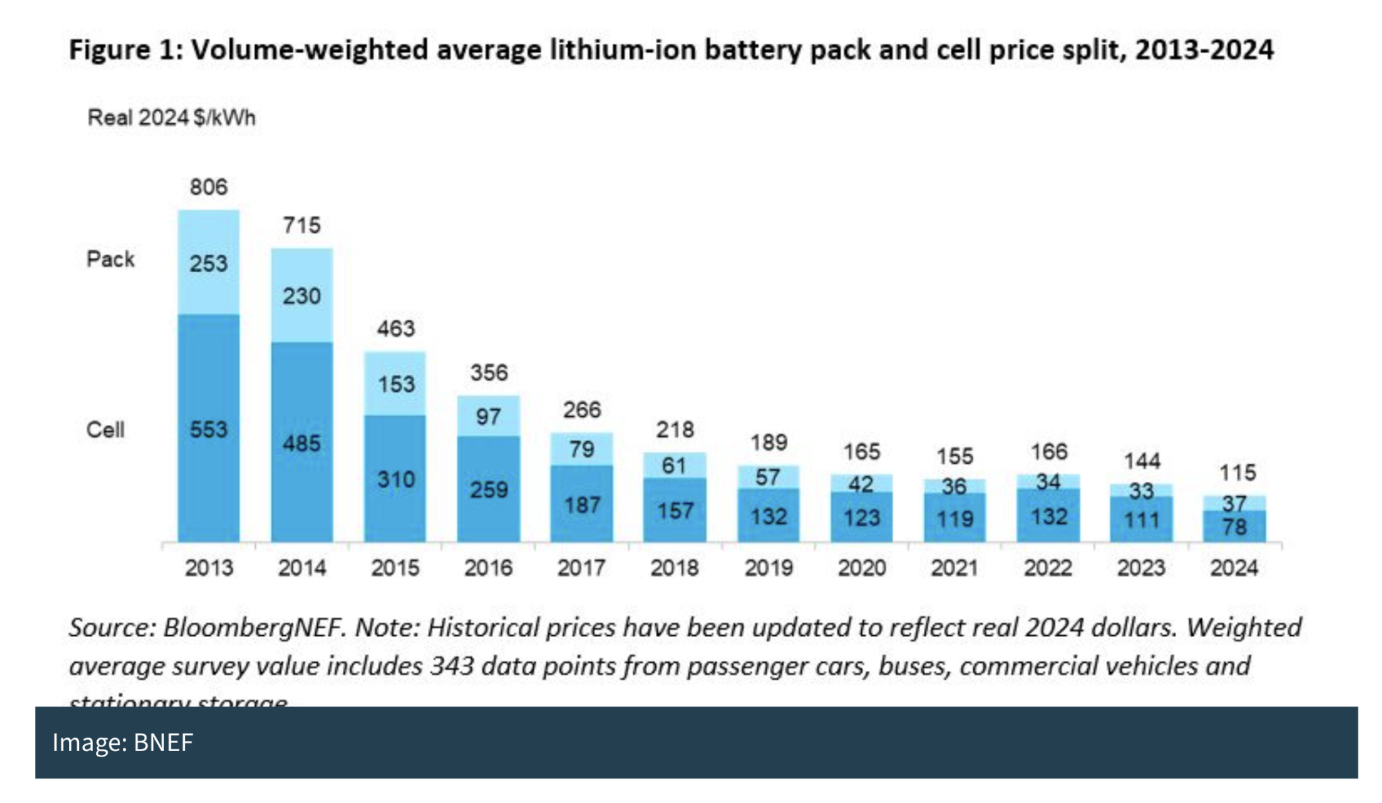
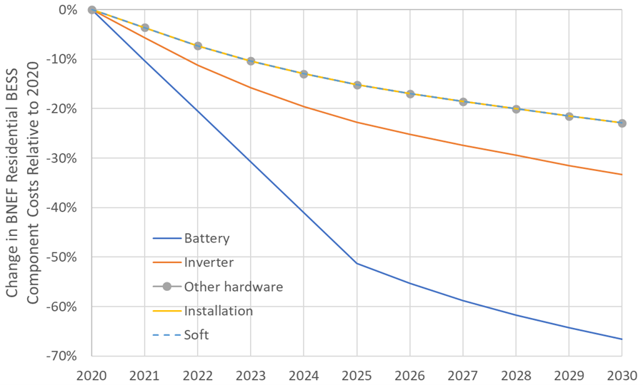
Li-ion price projections and history
Source: BNEF
Source: BNEF

Slide 18
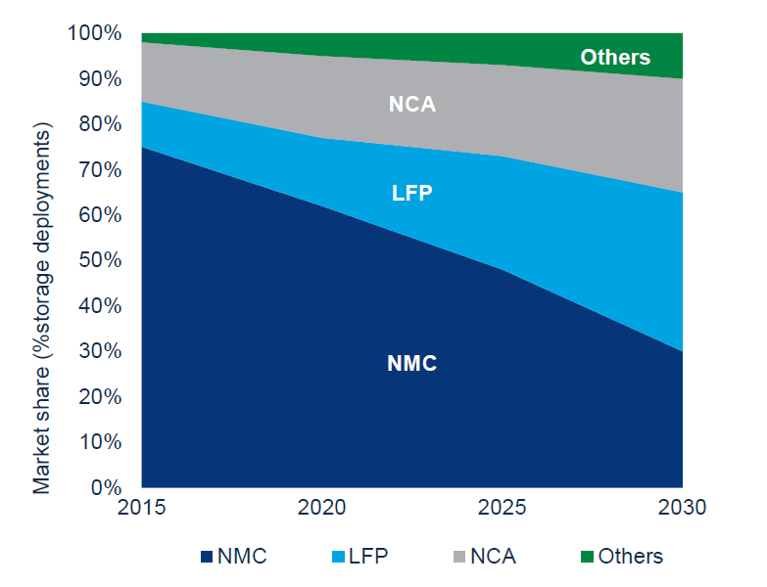
Market share of batteries
NCA, LFP, NMC all Li-ion technology
Source: Wood Mackenzie Energy Storage Service

Slide 19
Comparing Other Types of Batteries with Li-ion

